Slide 1
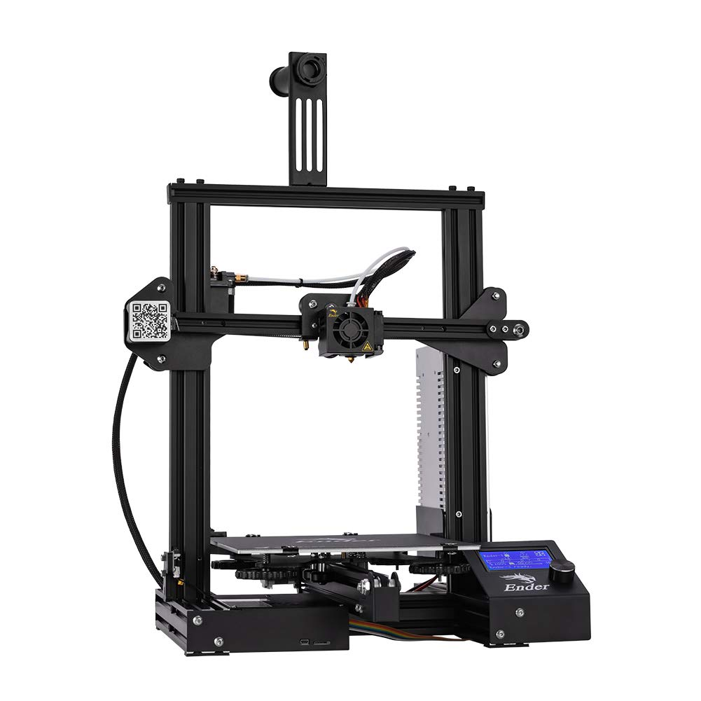

Team 21: 3D Printer and Application Interface
Bi-Weekly Update 2 Cody Hutchison Steven Liu Abigail Morar Sponsor: Dalton Cyr TA: Milenka Gamero
Notes:
Michelle

Slide 2
Project Summary
Current 3D printers require the user to manually upload a G-code file by an external storage device and initiate the printing process via controls on the printer
The new 3D printer and Application will allow the uploading, controlling, and initiation of printing from anywhere with internet access. The print time will also be within 10% of the Ender 3 printing time while also attempting to speed up the Z-axis movement speed.
Notes:
Kyle

Slide 3
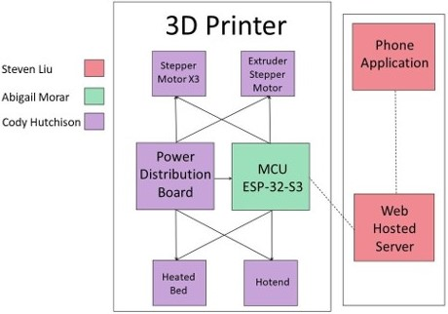
Project/Subsystem Overview
Notes:
Eric

Slide 4
Project Changes for 404
Everything is still on track from what was planned in 403.
As of now, changes are mostly geared towards fixing bugs in the current subsystems, preparing for full integration, and dealing with whatever problems may arise from that.
Notes:
Eric

Slide 5
Project Timeline
Validate System
Finish Subsystems
Integrate Subsystems
Final Presentation
Final Demo
February 15
March 15
March 29
April 10
April 24
Notes:
January 30th - February 5th
Ensure all parts required to complete PCBs are on hand or order more
Start populating PCB if they have arrived
February 6th - 12th
Have PCB populated and validate

Slide 6
Electrical Subsystem
Cody Hutchison
Accomplishments since last update 12 hrs of effort | Ongoing progress/problems and plans until the next presentation
- Assembling PCBs | Validate both PCBs Integrate PCB with MCU Design printer mount for PCBs

Slide 7
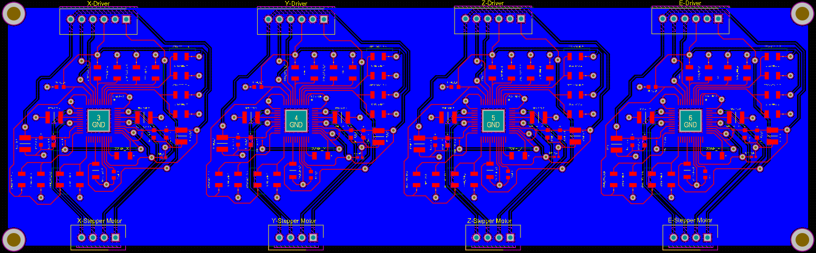
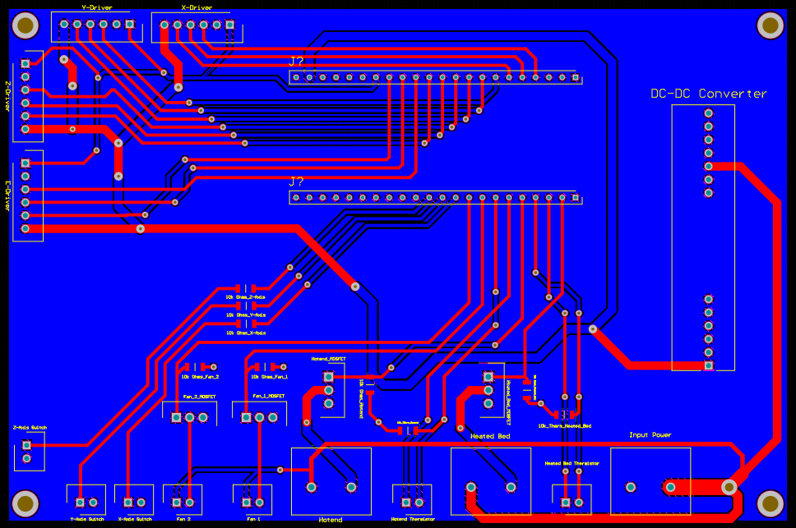
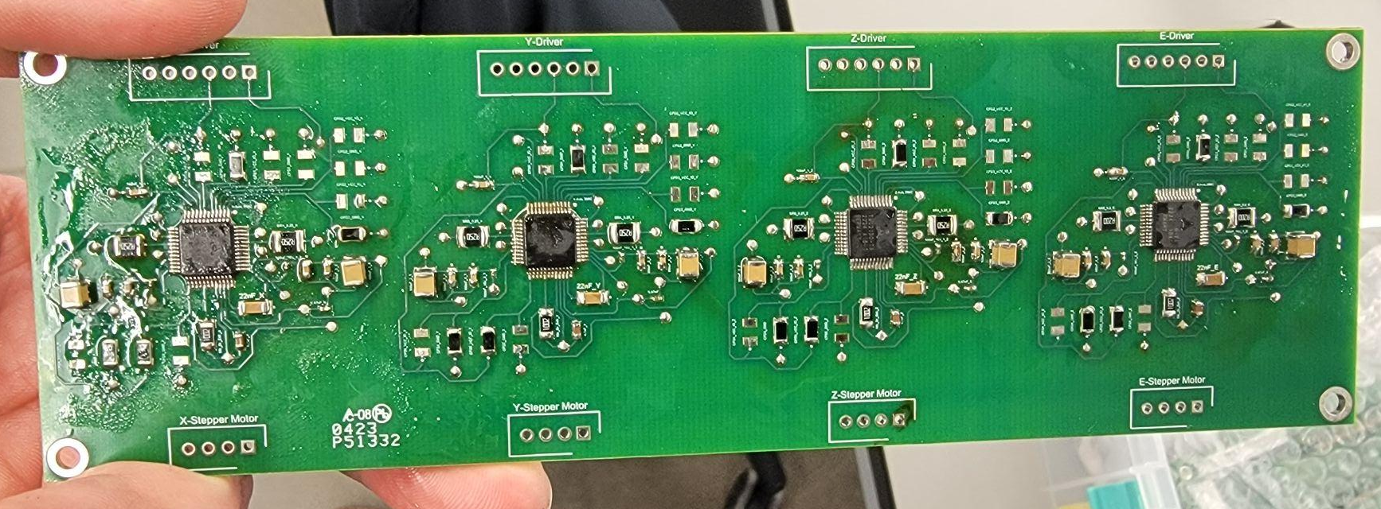
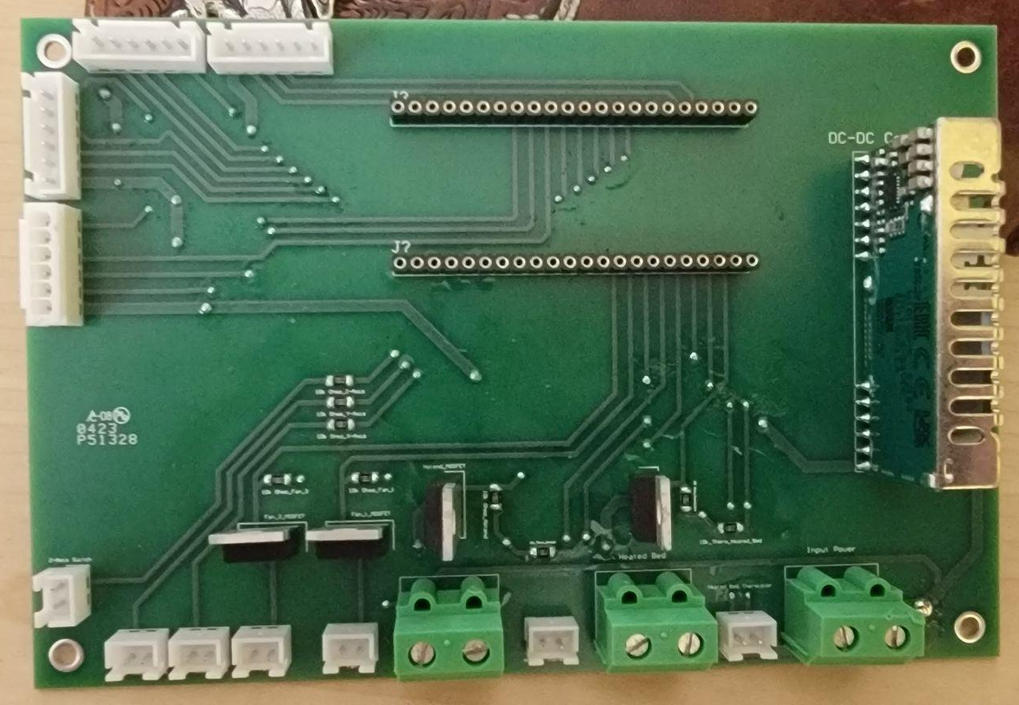
Electrical Subsystem
Cody Hutchison

Slide 8
Application and Server Subsystem
Steven Liu
Accomplishments since last update 25 hrs of effort | Ongoing progress/problems and plans until the next presentation
- Fixed display bug using Android SharedViewModel class - Fixed bug that would freeze and crash app on file upload cancellation - Working on using Firebase Functions to work around url communication bug | - Be ready for adjustments while integrating MCU - Fix url firebase communication bug - Look for other possible bugs or UI improvements

Slide 9
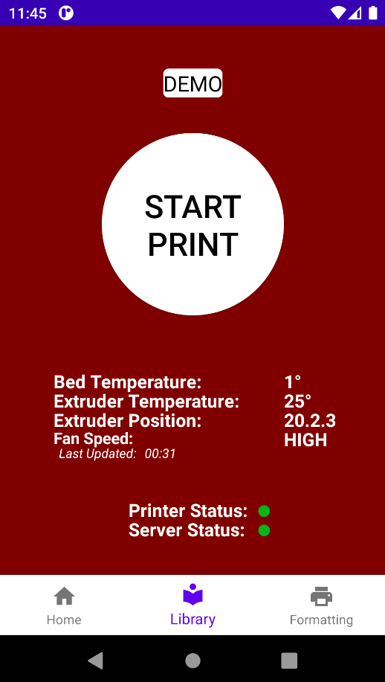
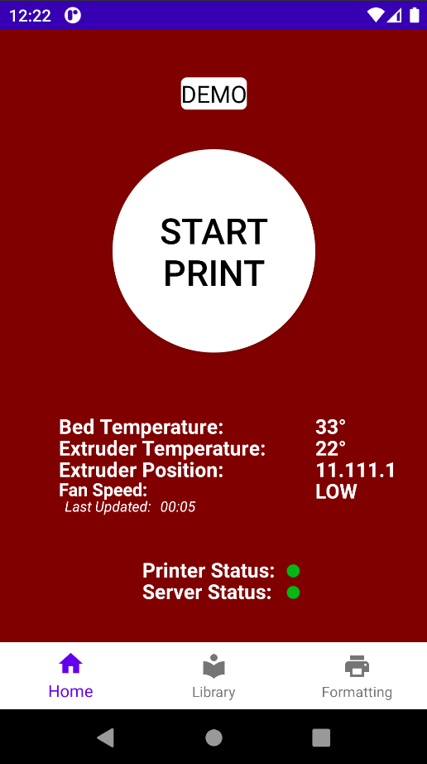
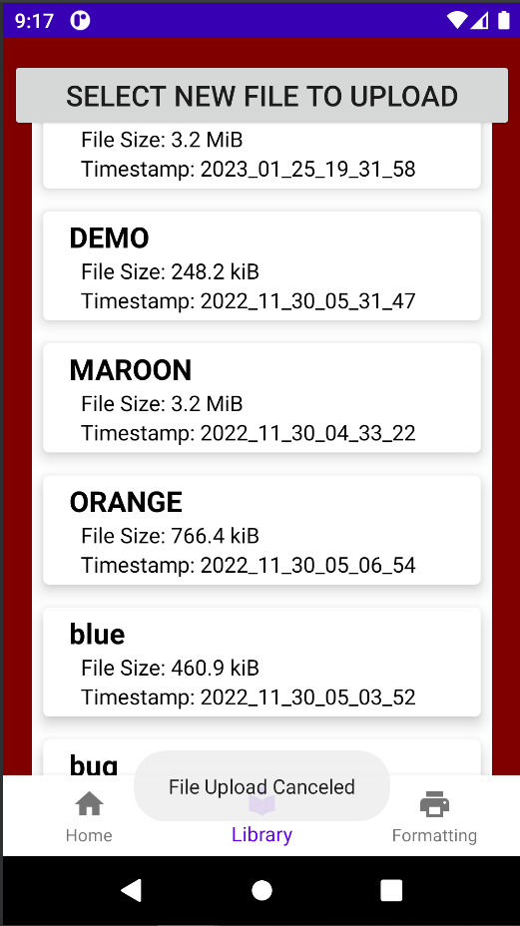
Application and Server Subsystem
Steven Liu
Display Bug
Display Bug Fixed
Cancel Upload Bug Fixed

Slide 10
Microcontroller Programming Subsystem
Abigail Morar
Accomplishments since last update 12 hrs of effort | Ongoing progress/problems and plans until the next presentation
- Began integration with Firebase server - Can write to correct path in Firebase | - Finishing up integration with the server to validate phone app communication - Will begin testing functionality of stepper motors and other components

Slide 11
Parts Ordering Status
All planned parts have been ordered and received
Notes:
Michelle

Slide 12
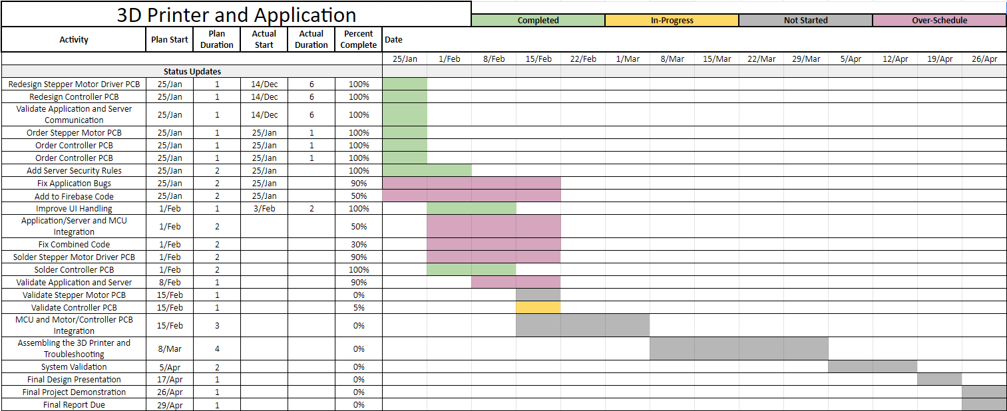
Execution Plan
Notes:
Michelle

Slide 13
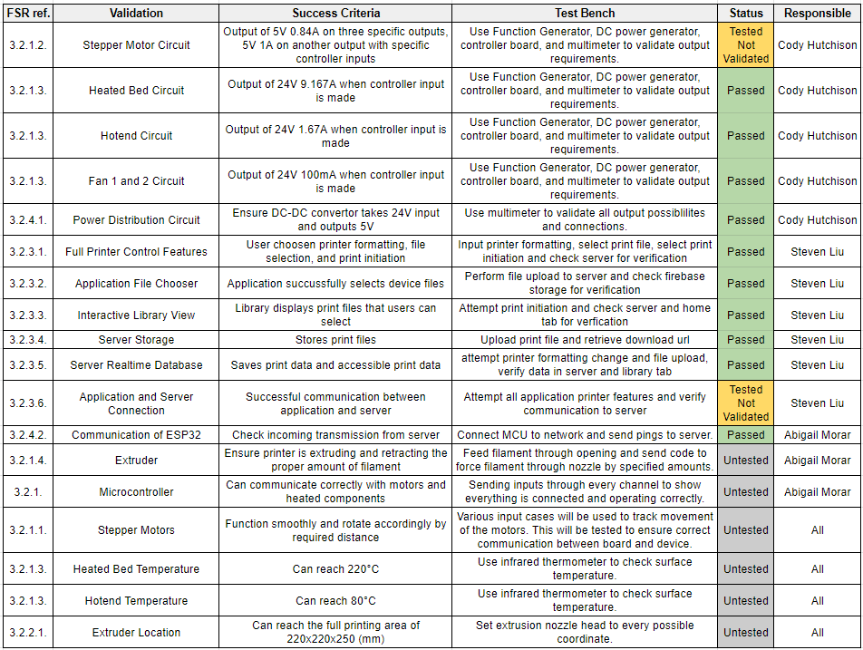
Validation Plan
Notes:
Michelle

Slide 14
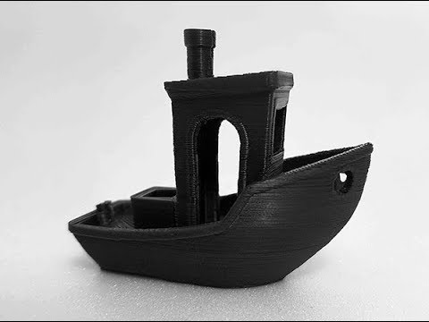
Questions? Comments?
Thank You

